Slide 1
Android Factory Reset and System Updates
Charles Liu
2014/8/7

Slide 2
Outline
Factory Reset
System Updates
Make OTA Image

Slide 3
Factory Reset :outline
Setting send reset cmd
Reboot to recovery mode
Erase data
Reboot

Slide 4
Factory Reset :setting
在settings中用户点击factory reset 按钮
private Button.OnClickListener mFinalClickListener = new Button.OnClickListener() {
public void onClick(View v) {
if (Utils.isMonkeyRunning()) {
return;
}
if (mEraseSdCard) {
Intent intent = new Intent(ExternalStorageFormatter.FORMAT_AND_FACTORY_RESET);
intent.setComponent(ExternalStorageFormatter.COMPONENT_NAME);
getActivity().startService(intent);
} else {
getActivity().sendBroadcast(new Intent("android.intent.action.MASTER_CLEAR"));
// Intent handling is asynchronous -- assume it will happen soon.
}
}
}; //mEraseSdCard=false的逻辑，其实就是发送一个广播 android.intent.action.MASTER_CLEAR

Slide 5
Factory Reset :setting
接收广播并处理
frameworks/base/services/java/com/android/server/MasterClearReceiver.java这个receiver
public void onReceive(final Context context, final Intent intent) {
if (intent.getAction().equals(Intent.ACTION_REMOTE_INTENT)) {
if (!"google.com".equals(intent.getStringExtra("from"))) {
Slog.w(TAG, "Ignoring master clear request -- not from trusted server.");
return;
}
}
Thread thr = new Thread("Reboot") {
@Override
public void run() {
try {
RecoverySystem.rebootWipeUserData(context);
Log.wtf(TAG, "Still running after master clear?!");
} catch (IOException e) {
Slog.e(TAG, "Can't perform master clear/factory reset", e);
}
}
};
thr.start();
}//RecoverySystem.rebootWipeUserData(context);准备做重启的动作，告诉系统要清除userData的数据

Slide 6
Factory Reset :RecoverySystem
RecoverySystem 静态方法rebootWipeUserData
frameworks/base/core/java/android/os/RecoverySystem静态方法rebootWipeUserData
public static void rebootWipeUserData(Context context) throws IOException {
final ConditionVariable condition = new ConditionVariable();
Intent intent = new Intent("android.intent.action.MASTER_CLEAR_NOTIFICATION");
context.sendOrderedBroadcastAsUser(intent, UserHandle.OWNER,
android.Manifest.permission.MASTER_CLEAR,
new BroadcastReceiver() {
@Override
public void onReceive(Context context, Intent intent) {
condition.open();
}
}, null, 0, null, null);
// Block until the ordered broadcast has completed.
condition.block();
bootCommand(context, "--wipe_data\n--locale=" + Locale.getDefault().toString());
}//重点命令bootCommand(context, "--wipe_data\n--locale=" + Locale.getDefault().toString());

Slide 7
Factory Reset :RecoverySystem
RecoverySystem 静态方法bootCommand
private static void bootCommand(Context context, String arg) throws IOException {
RECOVERY_DIR.mkdirs(); // In case we need it
COMMAND_FILE.delete(); // In case it's not writable
LOG_FILE.delete();
FileWriter command = new FileWriter(COMMAND_FILE);
try {
command.write(arg);
command.write("\n");
} finally {
command.close();
}
// Having written the command file, go ahead and reboot
PowerManager pm = (PowerManager) context.getSystemService(Context.POWER_SERVICE);
pm.reboot("recovery");
throw new IOException("Reboot failed (no permissions?)");
}//写命令到 /cache/recovery/command” 然后调用PowerManager进行重启操作，reboot()

Slide 8
Factory Reset :PowerManager
PowerManager # reboot
frameworks/base/core/java/android/os/PowerManager.java
public void reboot(String reason) {
try {
mService.reboot(false, reason, true);
} catch (RemoteException e) {
}
}/reason = “recovery”

Slide 9
Factory Reset :PowerManager
PowerManagerService# reboot
frameworks/base/services/java/com/android/server/power/PowerManagerService.java reboot 方法
public void reboot(boolean confirm, String reason, boolean wait) {
mContext.enforceCallingOrSelfPermission(android.Manifest.permission.REBOOT, null);
final long ident = Binder.clearCallingIdentity();
try {
shutdownOrRebootInternal(false, confirm, reason, wait);
} finally {
Binder.restoreCallingIdentity(ident);
}
}

Slide 10
Factory Reset :PowerManager
PowerManagerService# shutdownOrRebootInternal
private void shutdownOrRebootInternal(final boolean shutdown, final boolean confirm,
final String reason, boolean wait) {
if (reason.equals("recovery")) {
mTvManager = (TvManager)mContext.getSystemService(Context.TV_SERVICE);
if (mTvManager != null) {
mTvManager.setRecoveryCmd(BOOT_RECOVERY);
}
}
Runnable runnable = new Runnable() {
@Override
public void run() {
synchronized (this) {
if (shutdown) {
ShutdownThread.shutdown(mContext, confirm);
} else {
ShutdownThread.reboot(mContext, reason, confirm);
}}}
};
......
}//ShutdownThread.reboot(mContext, reason, confirm);一系列的方法调用后，由linux kernel根据
(“recovery”)进入rescue linux启动

Slide 11


Factory Reset :TvManager
Tvmanager
tvmanagerservice

Slide 12
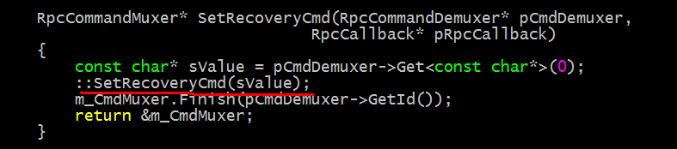
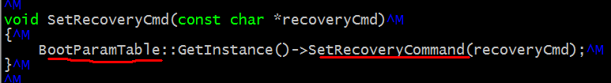
Factory Reset :TvManager
system/project/TvServer$ vi ./executor/EngineerFactoryApiExecutor.cpp
system/project/TvServer$ vi ./executor/RemoteAPI/EngineerFactoryApi.cpp
//set command

Slide 13
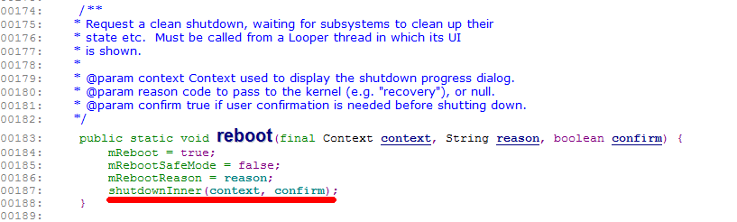
Factory Reset :ShutdownThread
ShutdownThreade# reboot

Slide 14
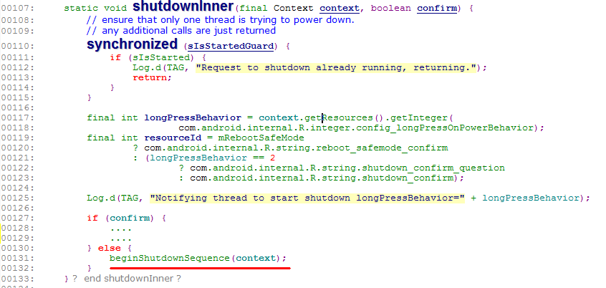
Factory Reset :ShutdownThread
ShutdownThreade# shutdownInner

Slide 15
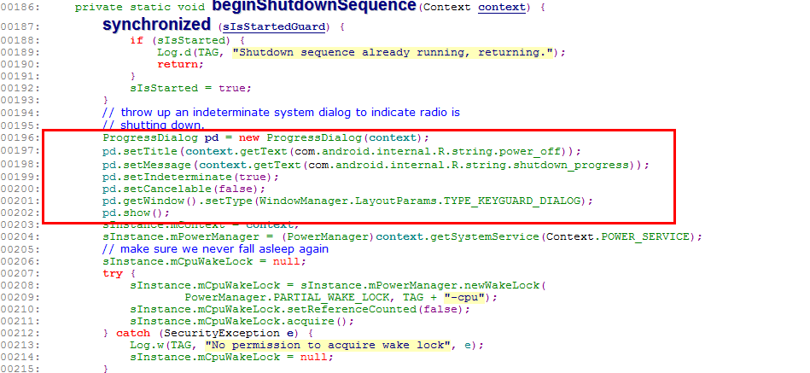
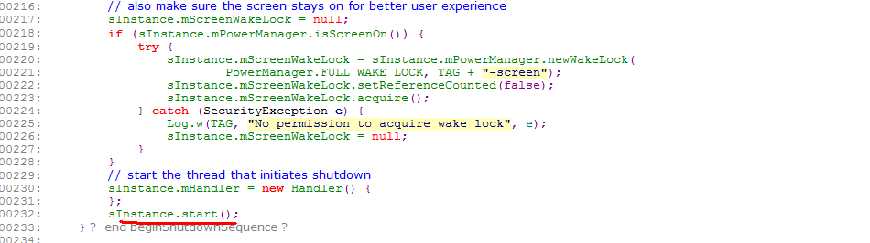
Factory Reset :ShutdownThread
ShutdownThreade# beginShutdownSequence

Slide 16
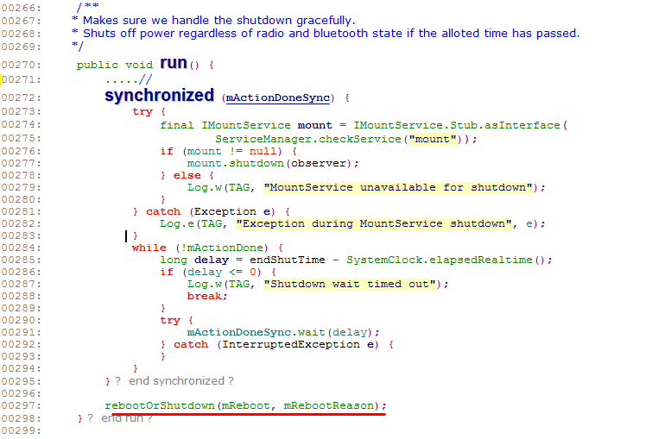
Factory Reset :ShutdownThread
ShutdownThreade# run
关掉一些服务，并call rebootOrShutdown(mReboot, mRebootReason);

Slide 17
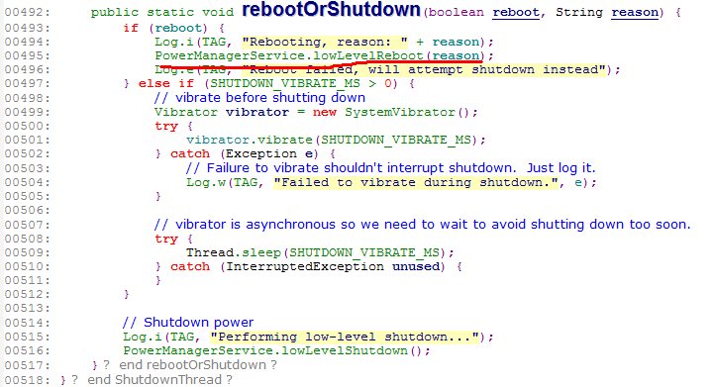
Factory Reset :ShutdownThread
ShutdownThreade# rebootOrShutdown
call PowerManagerService.lowLevelReboot 去最终执行重启动作

Slide 18
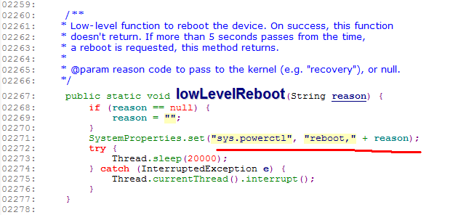
Factory Reset :ShutdownThread
ShutdownThreade# rebootOrShutdown

Slide 19

Factory Reset :ShutdownThread
device/realtek/rtd298x_tv001/init.rc

Slide 20
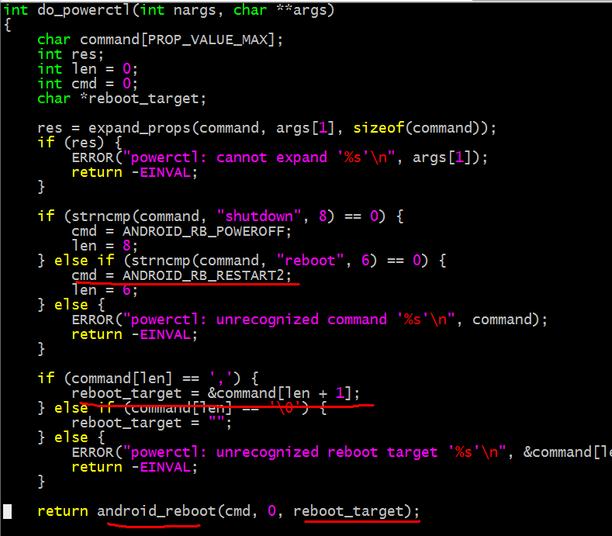
Factory Reset :ShutdownThread

Slide 21
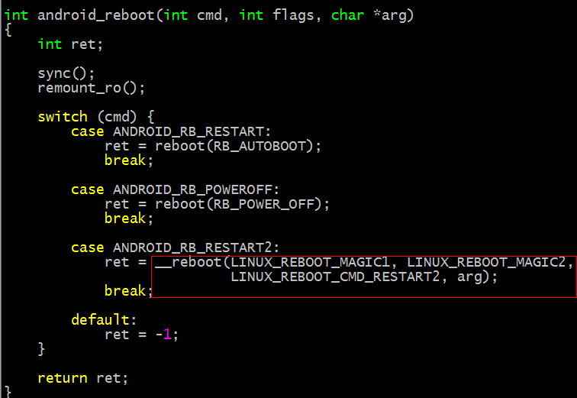
Factory Reset :ShutdownThread
system/core$ vi ./libcutils/android_reboot.c

Slide 22
Factory Reset :Rescue Linux
loader_m# main
开机启动进入loadM kernel/system/ap/develop/loader_m/loader_m.c
main(){
......
system("/sbin/recovery");
......
}//进入 recovery应用

Slide 23
Factory Reset :Recovery
int main(int argc, char **argv) {
......
get_args(&argc, &argv);
......
while ((arg = getopt_long(argc, argv, "", OPTIONS, NULL)) != -1) {
switch (arg) {
...
case 'u': update_package = optarg; break;
case 'w': wipe_data = wipe_cache = 1; break;
case 'c': wipe_cache = 1; break;
....
continue;
}}
......
if (update_package) {
...
}
//获取参数

Slide 24
Factory Reset :Recovery
// main 续
if (update_package != NULL) {
......
} else if (wipe_data) {
#ifndef RECOVERY_WIPEDATA_NOFORMAT
if (erase_volume("/data")) status = INSTALL_ERROR;
#endif
if (wipe_cache && erase_volume("/cache")) status = INSTALL_ERROR;
if (status != INSTALL_SUCCESS) ui->Print("Data wipe failed.\n");
} else if (wipe_cache) {
if (wipe_cache && erase_volume("/cache")) status = INSTALL_ERROR;
if (status != INSTALL_SUCCESS) ui->Print("Cache wipe failed.\n");
} else if (!just_exit) {
status = INSTALL_NONE; // No command specified
ui->SetBackground(RecoveryUI::NO_COMMAND);
}
...
android_reboot(ANDROID_RB_RESTART, 0, 0);
}
return EXIT_SUCCESS;
} //删除数据并重启
erase_volume 0 -1

Slide 25
Factory Reset :Recovery
static void get_args(int *argc, char ***argv) {
......
// --- if arguments weren't supplied, look in the bootloader control block
if (*argc <= 1) {
boot.recovery[sizeof(boot.recovery) - 1] = '\0'; // Ensure termination
const char *arg = strtok(boot.recovery, "\n");
if (arg != NULL && !strcmp(arg, "recovery")) {
*argv = (char **) malloc(sizeof(char *) * MAX_ARGS);
(*argv)[0] = strdup(arg);
for (*argc = 1; *argc < MAX_ARGS; ++*argc) {
if ((arg = strtok(NULL, "\n")) == NULL) break;
(*argv)[*argc] = strdup(arg);
}
LOGI("Got arguments from boot message\n");
} else if (boot.recovery[0] != 0 && boot.recovery[0] != 255) {
LOGE("Bad boot message\n\"%.20s\"\n", boot.recovery);
}
}
// --- if that doesn't work, try the command file
if (*argc <= 1) {
FILE *fp = fopen_path(COMMAND_FILE, "r");
if (fp != NULL) {
char *token;
char *argv0 = (*argv)[0];
*argv = (char **) malloc(sizeof(char *) * MAX_ARGS);
(*argv)[0] = argv0; // use the same program name
char buf[MAX_ARG_LENGTH];
for (*argc = 1; *argc < MAX_ARGS; ++*argc) {
if (!fgets(buf, sizeof(buf), fp)) break;
token = strtok(buf, "\r\n");
if (token != NULL) {
(*argv)[*argc] = strdup(token); // Strip newline.
} else {
--*argc;
}
}
check_and_fclose(fp, COMMAND_FILE);
LOGI("Got arguments from %s\n", COMMAND_FILE);
}
} .....
}
//命令行有recovery命令，优先执行命令行的recovery命令； 否则，往下查找/cache/recovery/command文件中的命令

Slide 26
System Updates :outline
Setting SystemUpdates
OTA Updates
Start System Updates
Reboot

Slide 27
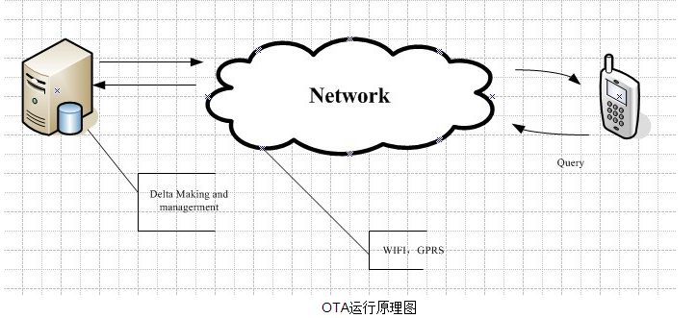
System Updates :Android OTA
Android平台提供Google diff arithmetic差分机制，升级包支持整包(Full Image)和差分包(Differential Image)
//OTA Server主要是对差分包的一个上传、下载以及版本的管理。
// 厂商通过差分包的制作工具制作出差分包，使用客户端进行上传和对版本的管理。
// Android设备通过WIFI/GPRS网络进行连接下载，然后完成更新

Slide 28
System Updates :setting
KK/device/realtek/app/RTKSettings/src/com/android/settings/deviceinfo/SystemUpdate.java
public class SystemUpdate extends Activity{
private static final String TAG = "SystemUpdate";
private String xmlUrl = "http://172.29.52.93/ota/ota.xml";
private String downloadPath = "/data/data/ota/";
private String otaPackagePath = "/storage/udisk/update.zip";
private String xmlPath = null;
private String packageUrl = null;
private String md5Str = null;
private String version = null;;
private String description = null;
View mContentView = null;
UpdateService mUpService = null;
boolean mBound = false;
private Context mContext;
private static int progress = 0;
….
}
//app for system updates

Slide 29
System Updates :setting
KK/device/realtek/app/RTKSettings/src/com/android/settings/deviceinfo/SystemUpdate.java
@Override
public void onCreate(Bundle icicle) {
xmlUrl = SystemProperties.get("ota_xml_url", "http://172.29.52.93/ota/ota.xml");
…..
if(!new File(otaPackagePath).exists()) {
((View)findViewById(R.id.bar_2)).setVisibility(View.GONE);
((TextView)findViewById(R.id.found_package)).setVisibility(View.GONE);
((Button)findViewById(R.id.btn_install_img)).setVisibility(View.GONE);
}
……//init views
Thread init = new Thread(checkUpdateRunnable);//checkUpdates()
init.start();
}
//start to check ota server

Slide 30
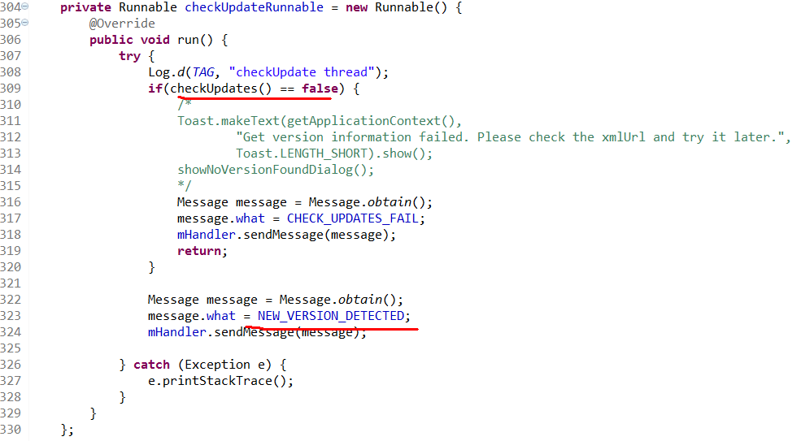
System Updates :setting
KK/device/realtek/app/RTKSettings/src/com/android/settings/deviceinfo/SystemUpdate.java
//start to check ota server

Slide 31
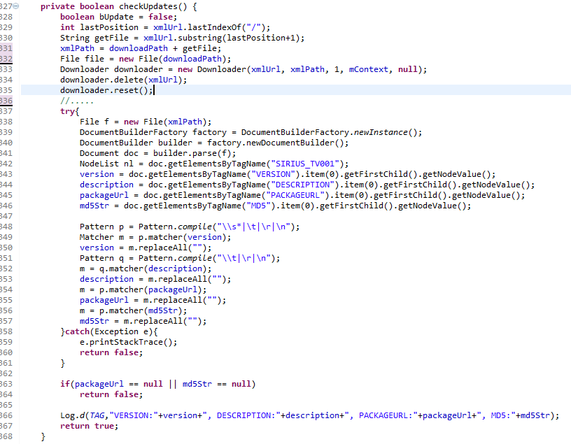
System Updates :setting
KK/device/realtek/app/RTKSettings/src/com/android/settings/deviceinfo/SystemUpdate.java
//get version/ packageUrl and md5 info

Slide 32
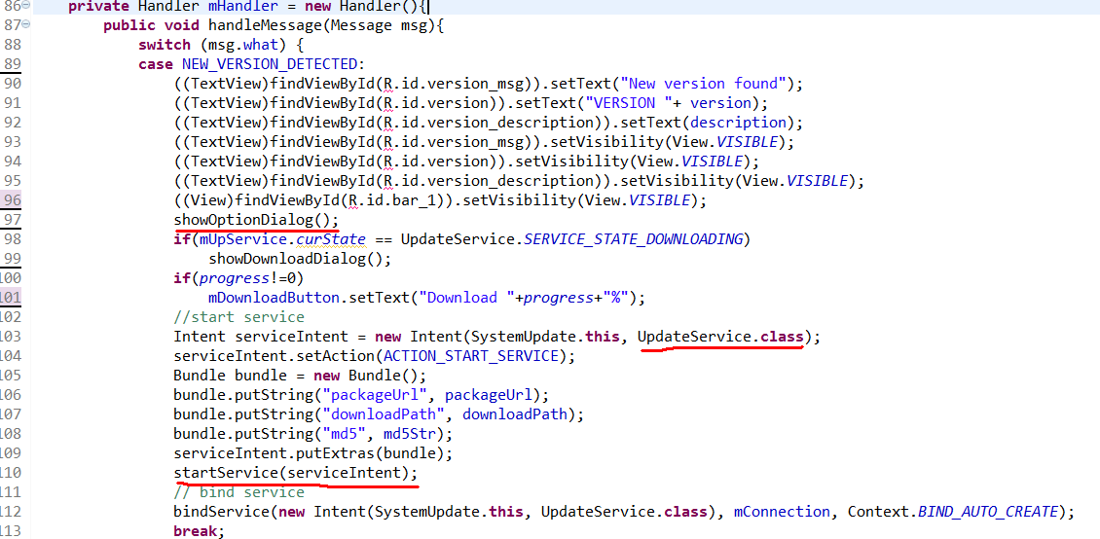
System Updates :setting
KK/device/realtek/app/RTKSettings/src/com/android/settings/deviceinfo/SystemUpdate.java
//启动service并设置参数

Slide 33
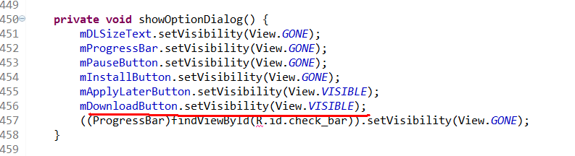
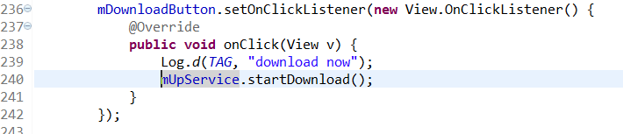
System Updates :setting
KK/device/realtek/app/RTKSettings/src/com/android/settings/deviceinfo/SystemUpdate.java
//mDownloadButton设置可见，可操作

Slide 34
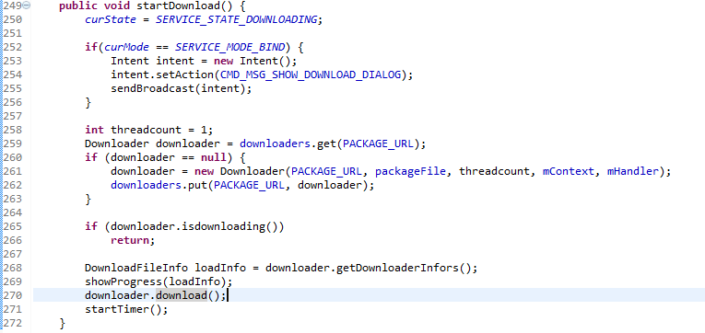
System Updates :OTA Updates
KK/device/realtek/app/RTKSettings/src/com/android/settings/deviceinfo/UpdateService.java
//use downloader to download img

Slide 35
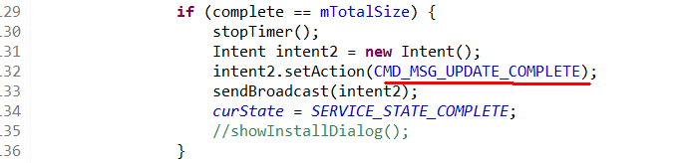
System Updates :OTA Updates
KK/device/realtek/app/RTKSettings/src/com/android/settings/deviceinfo/UpdateService.java
//下载完成，发送通知给SystemUpdate

Slide 36
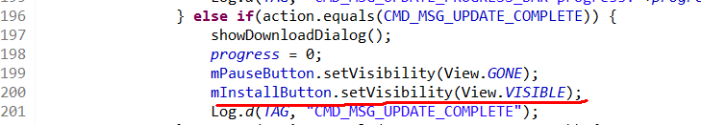
System Updates :OTA Updates
KK/device/realtek/app/RTKSettings/src/com/android/settings/deviceinfo/UpdateService.java
//mInstallButton设置可见，可操作

Slide 37
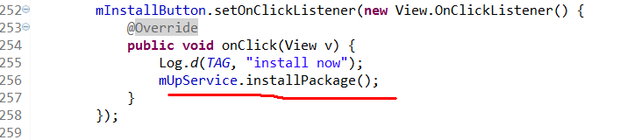
System Updates :OTA Updates
KK/device/realtek/app/RTKSettings/src/com/android/settings/deviceinfo/SystemUpdate.java
//user click ota update button

Slide 38
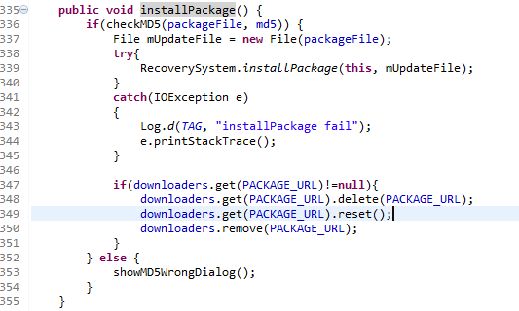
System Updates :OTA Updates
KK/device/realtek/app/RTKSettings/src/com/android/settings/deviceinfo/UpdateService.java
//call RecoverySystem.installPackage to install

Slide 39
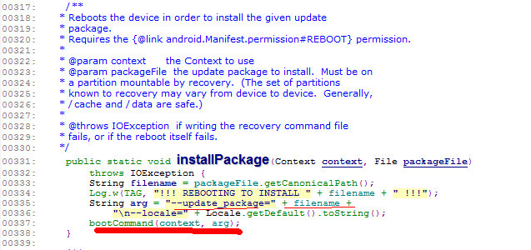
System Updates :RecoverySystem
KK/frameworks/base/core/java/android/os/RecoverySystem
// call booCommand to write arg “--update_package=<filename>”
//into “/cache/recovery/command”
//then reboot to recovery mode

Slide 40
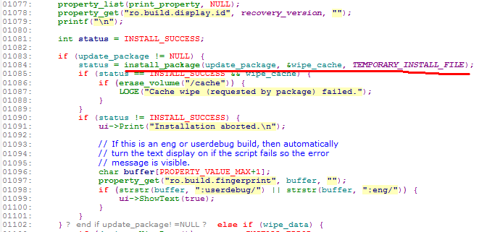
System Updates :Install Img
KK/bootable/recovery/Recovery.cpp # main
// call install_package

Slide 41
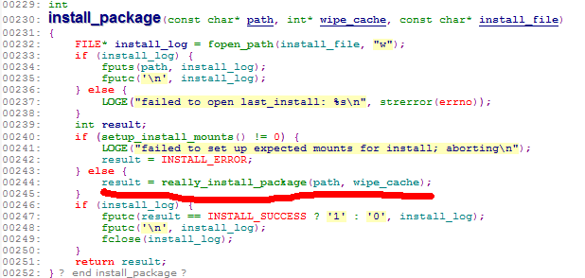
System Updates :Install Img
KK/bootable/recovery/Install.cpp # install_package
// call really_install_package

Slide 42
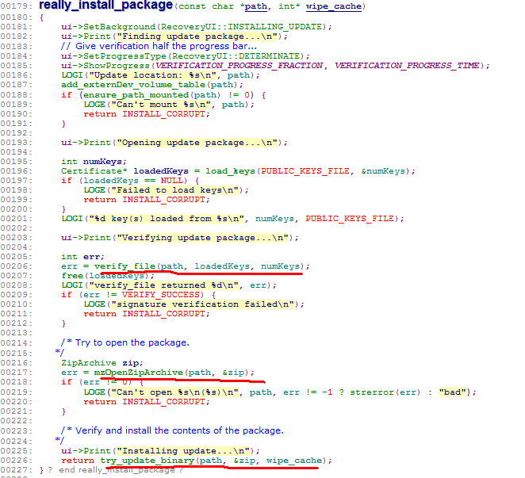
System Updates :Install Img
KK/bootable/recovery/Install.cpp # really_install_package
//check key then call try_update_binary to complete install flow

Slide 43
Outline
OTA Image
Build OTA Image
Makefile for OTA Build
ota_from_target_files
Burn OTA Image

Slide 44
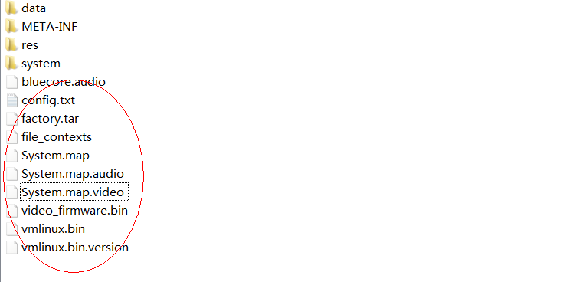
OTA Image
1.OTA Image 以update.zip来命名，分为整包和差分包两种，这里只讨论整包
2.update.zip 的目录结构

Slide 45
OTA Image
3.META-INF 的目录结构
|---META-INF/
|CERT.RSA
|CERT.SF
|MANIFEST.MF
|----com/
|----google/
|----android/
|----update-binary
|----updater-script
|----android/
|----metadata
|----otacert

Slide 46
OTA Image
3.META-INF 的目录说明
update-binary：是一个二进制文件，相当于一个脚本解释器，能够识别updater-script中描 述的操作。
updater-script：此文件是一个脚本文件，具体描述了更新过程。
metadata：文件是描述设备信息及环境变量的元数据。主要包括一些编译选项，签名公钥， 时间戳以及设备型号等。
MANIFEST.MF：这个manifest文件定义了与包的组成结构相关的数据。类似Android应用 的 mainfest.xml文件。
CERT.RSA：与签名文件相关联的签名程序块文件，它存储了用于签名JAR文件的公共签名。
CERT.SF：这是JAR文件的签名文件，其中前缀CERT代表签名者。
另外，在具体升级时，对update.zip包检查时大致会分三步：①检验SF文件与RSA文件是否匹配。②检验MANIFEST.MF与签名文件中的digest是否一致。③检验包中的文件与MANIFEST中所描述的是否一致

Slide 47
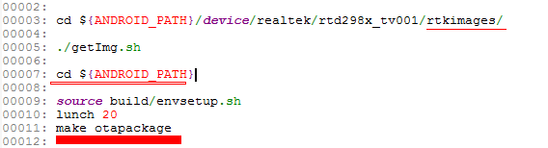
Build OTA Image
Steps：
1.Copy RTK related img
2.Make img

Slide 48
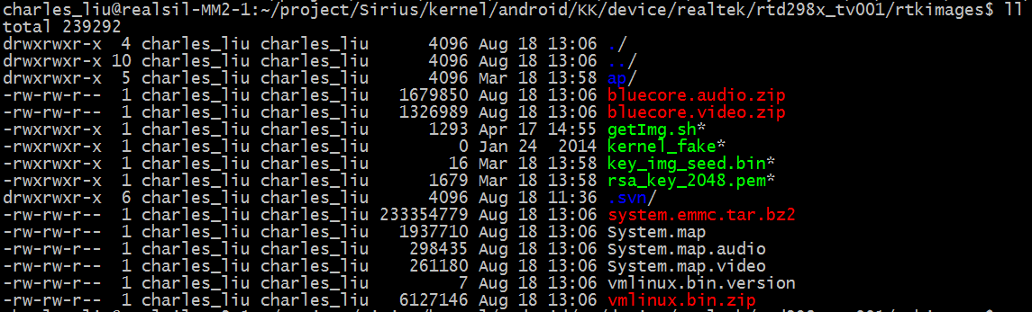
Build OTA Image
rtkimages：

Slide 49
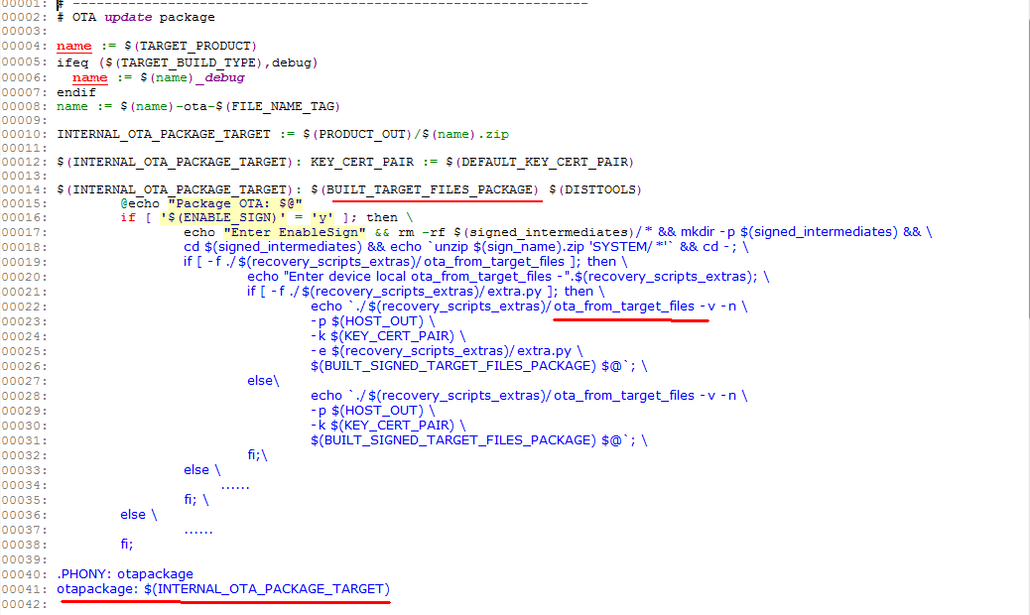
Makefile for OTA Build
Makefile文件所在位置：build/core/Makefile，从1458行是ota 部分
生成初始包
根据初始包，来生成ota img

Slide 50
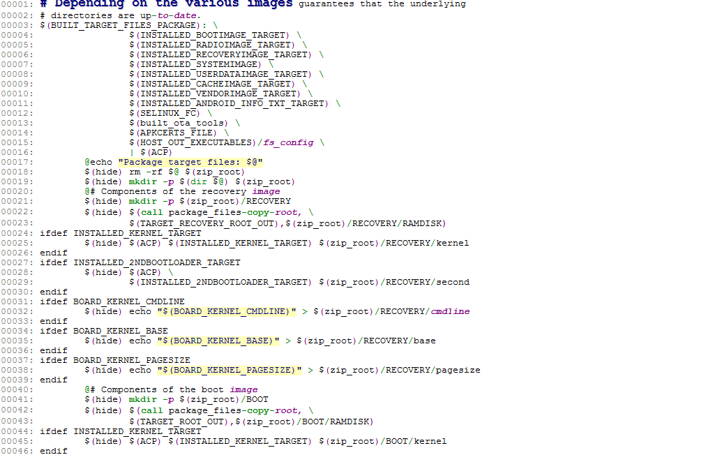
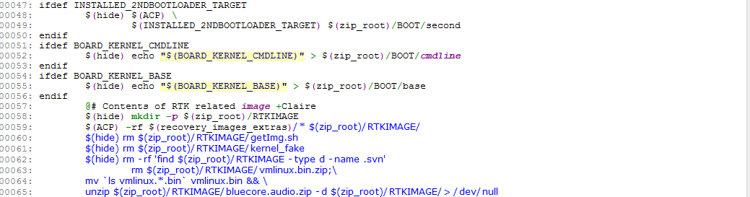
Makefile for OTA Build
BUILT_TARGET_FILES_PACKAGE：build/core/Makefile 1192行
创建Android image 的各个分区
Copy device/realtek/rtd298x_tv001/rtkimages里面的所有文件，并删除掉不用打包的文件，和做一些编辑

Slide 51
Makefile for OTA Build
BUILT_TARGET_FILES_PACKAGE的过程分析
首先创建一个root_zip根目录，并依次在此目录下创建所需要的如下其他目录和文件
1.创建RECOVERY目录，并填充该目录的内容，包括kernel的镜像和recovery根文件系统的镜像。此目录最终用于生成recovery.img。
2.创建并填充BOOT目录。包含kernel和cmdline以及pagesize大小等，该目录最终用来生成boot.img。
3.向SYSTEM目录填充system image。
4.向DATA填充data image。
5.用于生成OTA package包所需要的额外的内容。主要包括一些bin命令。
6.创建META目录并向该目录下添加一些文本文件，如apkcerts.txt(描述apk文件用到的认证证书)，misc_info.txt(描述Flash内存的块大小以及boot、recovery、system、userdata等分区的大小信息)。
7.重点是添加rtkimages里面的文件，并做一些编辑
8.使用保留连接选项压缩我们在上面获得的root_zip目录并最终得到初始包

Slide 52
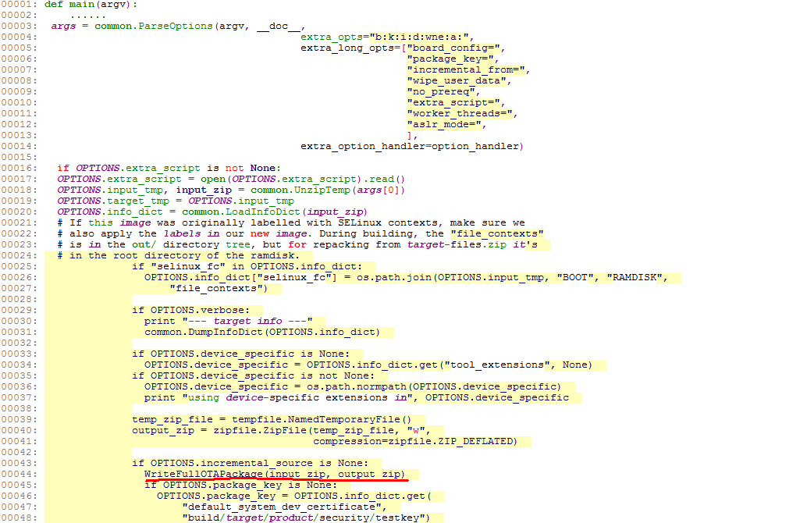
ota_from_target_files
前面的makefile会调用ota_from_target_files来生成ota 包
WriteFullOTAPackage来生成完整包

Slide 53
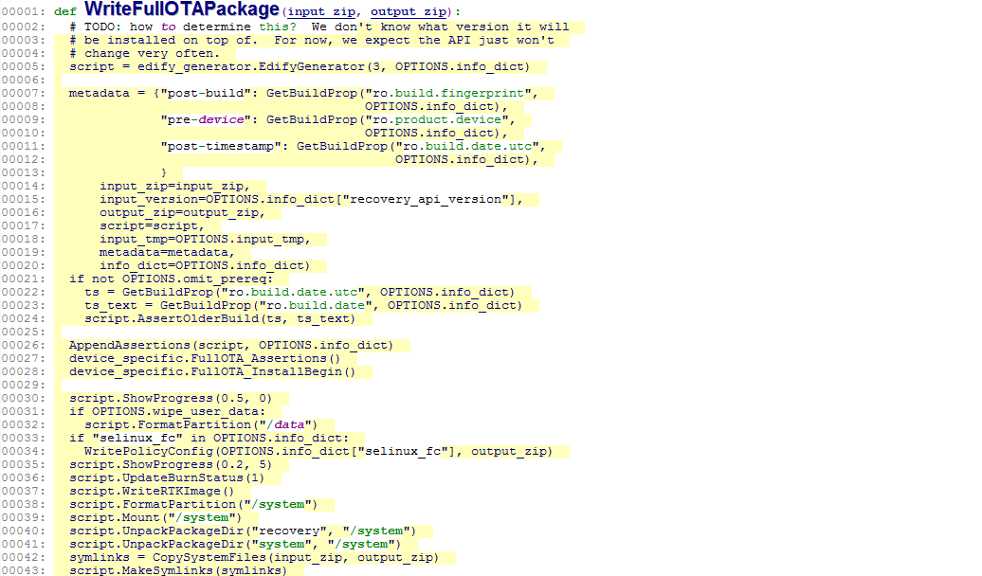
ota_from_target_files
ota_from_target_files # WriteFullOTAPackage
创建脚本生成器
实现见脚本：edify_generator.py
添加脚本执行的flow，包括处理system、data等分区，还包括我们平台相关的rtkimage相关文件的burn命令

Slide 54
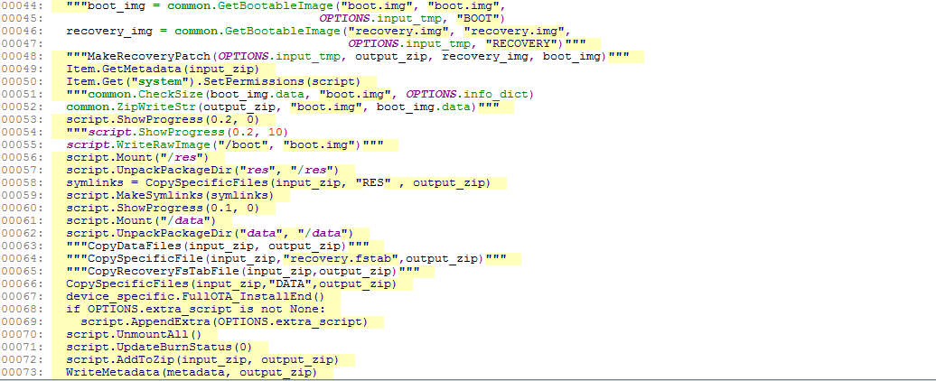
ota_from_target_files
ota_from_target_files # WriteFullOTAPackage
处理data分区和res分区的script命令
1.将前面生成的脚本输出到：META-INF/com/google/android/updater-script
2.将升级程序：OTA/bin/updater 从输入ZIP包中拷贝到输出ZIP包中的：META-INF/com/google/android/update-binary
将前面获取的metadata 写入输出包的文件中： META-INF/com/android/metadata
至此，我们就得到了一个update.zip包

Slide 55
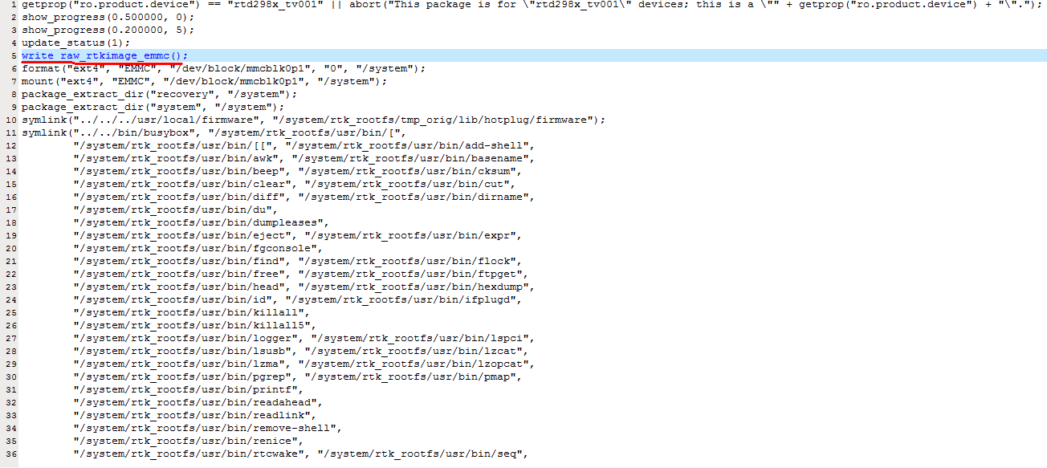
ota_from_target_files
生成的META-INF/com/google/android/updater-script

Slide 56
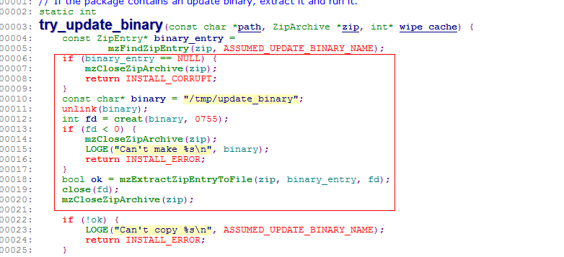
Burn OTA Image
Recovery.cpp#main→Install.cpp#install_package→really_install_package→try_update_binary
提取升级包中的"META-INF/com/google/android/update-binary"文件，此文件定义了系统升级所需要进行的操作，系统将根据其中的命令执行相应的操作

Slide 57
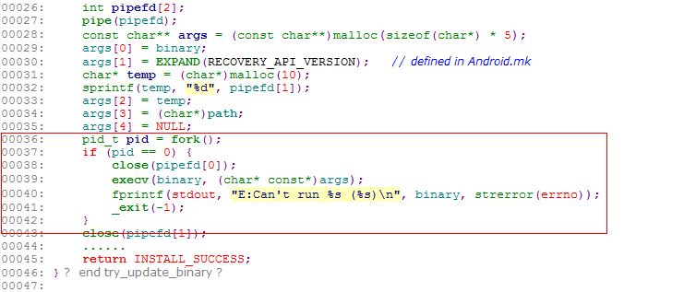
Burn OTA Image
Recovery.cpp#main→Install.cpp#install_package→really_install_package→try_update_binary
创建一个子进程，执行脚本文件META-INF/com/google/android/update-binary，这是系统升级的核心所在

Slide 58
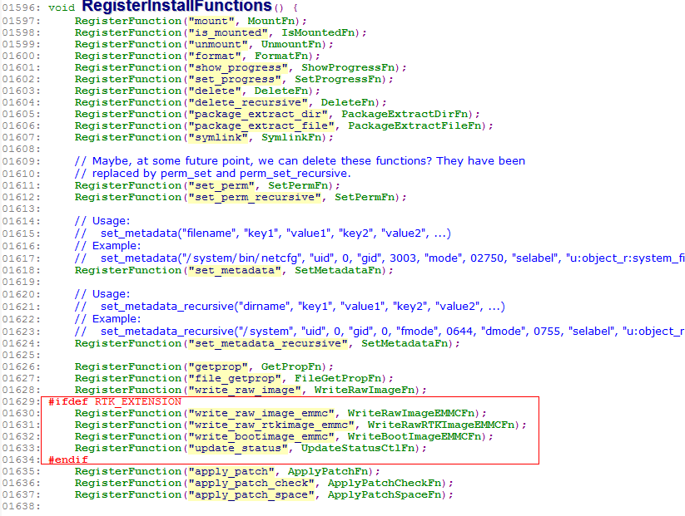
Burn OTA Image
update-script中的命令对应的方法：
bootable/recovery/updater/install.c#RegisterInstallFunctions
Rtk platform相关的flash命令
write_raw_rtkimage_emmc：WriteRawRTKImageEMMCFn

Slide 59
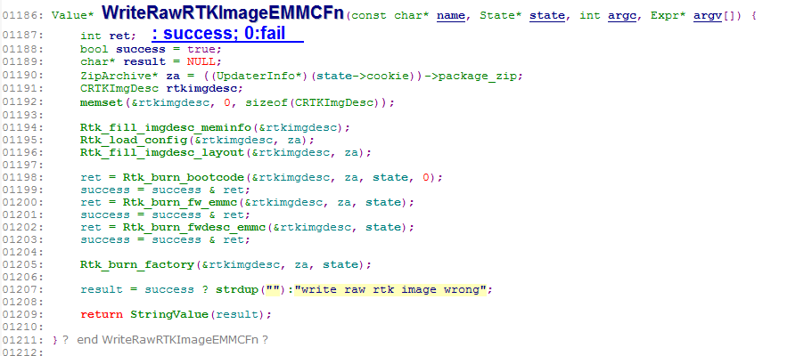
Burn OTA Image
bootable/recovery/updater/install.c#WriteRawRTKImageEMMCFn

Slide 60
Thanks

